Slide 1
THE FLYWHEEL OF GROWTH WORKBOOK

Slide 2
Table of Contents
What is a Flywheel?
How do you use it?
Examples
Templates for building your own

Slide 3
INTRO

Slide 4
What is strategy?
In essence, the answer to these two questions: “Where will we play, and how do we win?”
The templates in this workbook will help you visualize your answers to each of them.
* Playing to Win: How Strategy Really Works (2013)

Slide 5
What makes for a great innovation strategy?
What makes for a great strategy in the age of innovation?
Notes:
I’ve often heard people ask what a good or great innovation strategy is like.
Well, I think that’s actually the wrong question to ask. If we just try to think about that, it’s really hard to come up with a good answer that applies in every situation.
The question we really need to is what makes for a great strategy… in the age of innovation.
Once we a great strategy in the place, deriving the role of innovation from that is actually very straightforward.
We just figure out what needs to be done, and we get it done!

Slide 6
Competitive Advantage in the Age of Innovation
Willingness & Ability to Adapt
Pace of Innovation
Strong Ecosystem (Flywheel)
Notes:
Now, if we then look at what makes a great strategy in the age of innovation, we need to look back at what we’ve previously learned, and the key thing to remember from those lessons is that achieving a sustainable competitive advantage simply by making the right strategic choices is no longer a reality for most.
However, there clearly are still many companies that are doing extremely well.
We’ve been researching and studying them and their innovation strategies long and hard, and here’s what we think it all ultimately boils down to.
First, we have a strong ecosystem. That’s obviously a very broad concept, but the basic idea is that your business should strive to create an ecosystem where the parts make the whole stronger.
If you are able to do this, any positive changes to one part of the ecosystem will inevitably lead to positive changes in other parts of the ecosystem, creating a virtuous cycle, or a Flywheel.
Another term used for pretty much the same thing is what Square co-founder Jim McKelvey calls the Innovation Stack. The idea there is again very much the same than with the ten types of innovation framework we talked about earlier.
The best kind of an innovation is one where you can rethink the whole industry or ecosystem from top to bottom to be one cohesive stack redesigned with innovations across all levels.
This will obviously provide you with a very strong core that you can build a solid competitive advantage around.
Now, this is a very difficult topic to truly understand, so don’t worry if you didn’t quite get it. We will come back to this topic in more detail in an upcoming lesson with plenty of examples.
Second, the pace of innovation is absolutely vital here. In today’s hyperconnected world, if you just have one good idea and implement that, it’s just a matter of time before someone realizes what you did, doubles down on that and blows right past you. In most cases, even patents won’t protect you if you don’t keep innovating at a relentless pace.
On the other hand, if you just keep getting better at what you do, churning out smaller and bigger innovations one after the other, that is typically enough to create a very strong competitive advantage in your business, even without that kind of a strong ecosystem.
This is also something we’ll get back to in more detail later on during the course.
Finally, there is the willingness and ability to adapt. No matter how strong the other two are, even they aren’t likely enough to grant you a lasting competitive advantage because no matter how dominant you are in your current business, the market is shifting so rapidly that your old business won’t exist forever. As a result, you need to be willing and able to monitor and adapt to the changing world.
After all, just like with evolution, it isn’t the strongest or the most intelligent who survive, but the most adaptable to change.

Slide 7
What is a Flywheel?
First introduced by Jim Collins in Good to Great
The key idea: There isn’t a single magical moment that leads to success, it comes from years of hard work in building a system that accelerates little by little, until momentum finally takes over to power sustained periods of accelerated growth
If you look at any of the most successful companies in the world, they all have their own Flywheels
There are different kinds of Flywheels, but the key idea is that there’s a combination of elements that gains from economies of scale, which creates a self-reinforcing virtuous cycle for the company

Slide 8
How do you use this workbook?
The Flywheel of Growth is a strategic tool for innovators
The Flywheel is a great way to help focus your innovation efforts towards the things that actually move the needle
Examples help illustrate the concept and provide inspiration for your own Flywheel
Make sure to read the Presenter notes for more detailed descriptions of each example
The Templates then help you plan, visualize and communicate your (innovation) strategy
Use them in presentations, day-to-day communications, or even hang them on the wall

Slide 9
EXAMPLES

Slide 10
LOWER COSTS
FASTER DELIVERY
LOWER PRICES
SELECTION
CUSTOMER EXPERIENCE
TRAFFIC
SELLERS
INFRASTRUCTURE
Notes:
This is Amazon’s Flywheel
It all starts with a large selection, which creates a great customer experience for “the everything store”
A great customer experience ensures that people come back and tell their friends, leading to more traffic
More traffic means that more sellers are interested in selling their own goods on Amazon
More sellers means there’s more selection available, further accelerating the growth
The growth ultimately requires larger investments in infrastructure, but these allow Amazon to achieve an even lower cost structure, which can be transferred into lower prices, which again improves user experience
A solid infrastructure also leads to a more reliable and faster delivery, which again improves customer experience
This doesn’t even show Amazon’s other initiatives, such as AWS, content, and devices, all of which not only were made possible by Amazon’s scale, but also create additional synergies, further powering their core Flywheel

Slide 11
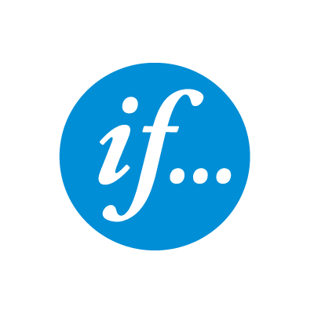
CUSTOMER EXPERIENCE
LESS CHURN, WORD OF MOUTH
GROWTH + PROFIT
RETAIN & ACQUIRE MORE CUSTOMERS
Notes:
This is the case of a large international insurance company that Viima has worked closely with.
They operate in a very challenging and competitive industry that is facing pressure and disruptive threats from many directions
After several challenging years, they launched a new strategy that focused on innovation and continuous improvement of customer experience as ways to gain competitive advantage some five years ago.
Ever since, the improved customer experience has helped the company reduce their churn and increase customer lifetime value (LTV).
The positive word of mouth from a great customer experience in an industry where that is still the exception has also helped the company acquire more good customers
…and the cumulative effect of these improvements has reversed the declining trend in sales into impressive growth
Continuous stream of additional investments and hundreds of incremental improvements aimed at improving customer experience keep accelerating the loop and providing a sustainable source of competitive advantage in this highly competitive industry where customer retention (of the right clients) is key for achieving solid business performance

Slide 12
FEATURE-RICH ONLINE STORE IN MINUTES
MERCHANTS
DEVELOPERS
3rd PARTY APP ADD-ONS & NEW CHANNELS
Notes:
Shopify, the e-commerce platform, has a Flywheel that is quite simple, but beautiful:
They allow anyone to set up a feature-rich online store in minutes with no up-front investment
This has obviously led to the platform having many merchants, there are already more than a million stores running on the platform
This huge pool of business customers obviously attracts many developers to help merchants further customize their store on Shopify
These developers can also publish add-ons they’ve developed in the Shopify App Store that allows merchants to add new features with no coding whatsoever. Some of these add-ons allow the stores to expand to entirely new channels, such as Instagram.
Previously these kinds of additions required a dedicated team and huge up-front investments for each new channel.
Many merchants -> Many developers -> App store for 3rd party app add-ons -> More elaborate features and new channels that were previously only available to huge enterprises and required years of development with huge up-front investments
These additional capabilities at a highly affordable price that are immediately available obviously helps lure even more merchants to the platform

Slide 13
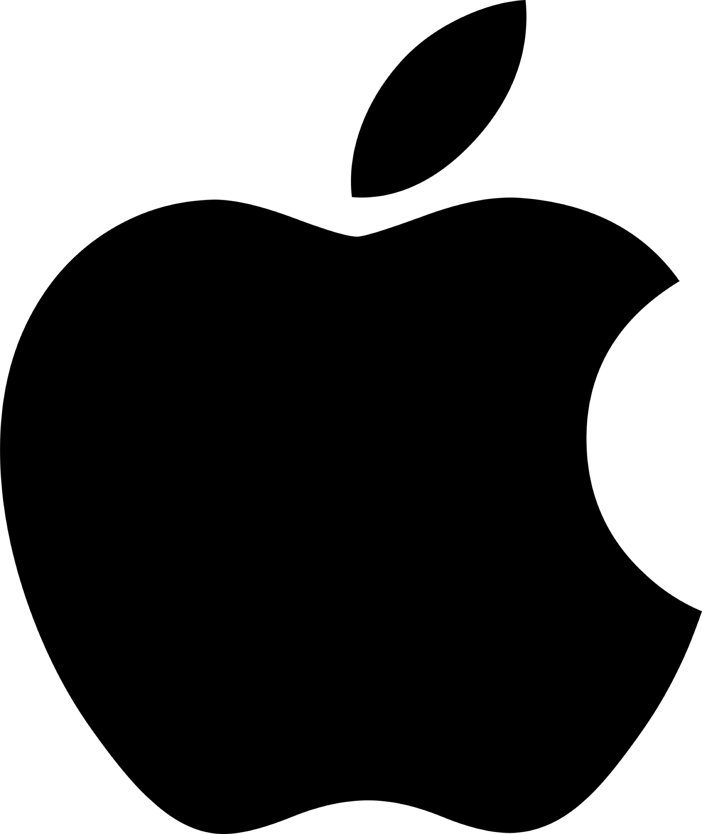
3RD PARTY DEVELOPERS
HIGH-END DEVICES
CUSTOMER EXPERIENCE
APPS & SERVICES
ACCESORIES
LOCK-IN
Notes:
Apple is another example of a great Flywheel
The core of Apple’s business has always been high-end computing devices, be it computers, phones, tablets, etc.
Since the iPod, they’ve usually been the not the first to market, but the first to reach large scale on every new computing platform, most notably the iPhone and the iPad
This has allowed them to build a large base of active users of their high-end devices that are willing to pay more than users of competing platforms
This has made it very lucrative for both themselves, as well as 3rd party developers to create additional apps and services for their devices
These apps and services further improve the customer experience of the devices
This not only helps keep people in the Apple ecosystem, but also makes them more willing to pay for additional accessories and devices, be it AirPods or an Apple Watch, which help the company grow additional revenue streams and provide a customer experience that is guaranteed to be great
All of the elements work together to create a better customer experience within the ecosystem, while simultaneously increasing switching costs to help the company better retain customers and get them to buy new devices
What’s noticeable here is that even though their iPhone sales have stagnated, the rest of the elements are starting to take over, providing them with the ability to maintain the momentum and find new avenues for future growth!

Slide 14
SUPERIOR PRODUCT
STRONG BRAND MARKETING
WORD OF MOUTH
…FOCUSED ON MEGATRENDS
Notes:
Next, we have Oatly.
Most of the examples here have a very strong digital component, and that’s because the best companies in the world, regardless of industry, are almost universally the ones that have embraced digital.
However, it doesn’t always have to be the case since there are also other kinds of innovation and Flywheels, and Oatly is a great example of that.
They are a company that was actually founded in the early 1990s, and had become a pretty stable and boring company, until 2014 when their current CEO joined the company, and saw an opportunity for growth.
They expanded beyond their regular milk alternative product and focused on niche markets where they had a much stronger value proposition, most importantly coffee milk alternatives with their Barista Edition.
It is universally seen as a superior product for this use case, everyone prefers the taste to any other coffee alternative, and it foams just as well as traditional milk, which is especially important for making those lattes and cappuccinos, which a lot of millennials like to drink.
That was also the perfect opportunity to create an edgy and fun brand riding on the megatrends of both health and sustainability, which they did.
The brand, creative marketing, and great product together led to an incredible surge in word of mouth, and a huge demand spike.
Before the company was able to ramp up their production, there were widespread shortages which led to the products selling for as high as $25 per carton, showing how much people loved the combination of the brand and the great product,
…and that loyalty and incredible demand of course further strengthened the brand and created more word of mouth and demand
As a result, the company’s grown at an incredible pace in the last few years with revenue growing 65% in 2018.
Now, some of you might ask what the innovation was there?
Well, the most visible part of that is their marketing and brand innovation, which was extremely distinctive and fresh, but the thing that enabled all of that in the first place is that they also have pretty hardcore R&D capabilities since no one to date has been able to come close to having as good of a product as Oatly’s barista edition.

Slide 15
ICONIC CHARACTERS + QUALITY CONTENT
STRONG BRAND
LOYAL FANS
NEW FRANCHISES
PARKS
MERCHANDISING
Notes:
Disney
Disney has been known for creating iconic characters and quality content and entertainment, being a pillar of childhood throughout the world
Their reputation for trustworthy content has led to a tremendously strong brand and a loyal following
This strong fanbase has enabled to company to build very sizeable park and merchandising businesses, which further strengthen the fan experience, creating an even stronger brand and more loyal fans
All of this has led to sustained financial success, which has allowed the company to invest in creating and acquiring additional franchises that allow them to expand the Disney family

Slide 16
TECH + VALUE LEADERSHIP
WORD OF MOUTH
CUSTOMER EXPERIENCE & BRAND
SCALE
INNOVATION & VERTICAL INTEGRATION
ENERGY GENERATION & STORAGE
DATA FOR AI DEVELOPMENT
Notes:
Tesla
Tesla has been in a pioneer in electric vehicles, and sustainable transportation + energy at large. In practice, they have a technological advantage over the competition, but also a reputation as having strong values that speak to customers.
Together the combination of strong values and technological leadership has created a great customer experience and very strong brand
This is best evidenced by an NPS of 91 for the Model 3 (Bloomberg, 2019), which is the highest we’ve ever seen for any product
A very strong brand and customer experience have created enormous publicity and word of mouth for the company
Without any advertising, the company has been able to retain a roughly 50% annual growth rate and would seem to be only limited by their production capacity
Strong demand allows them to scale production volumes, which helps them reduce costs, allowing them to invest more in innovation
Innovation helps further reduce cost and improve manufacturing effectiveness, which helps additional scaling
Vertical integration has been a key enabler for both keeping costs low, as well as keeping the pace of innovation very quick and ensuring a great end-to-end customer experience
Thanks to its large fleet of cars on the road with all the sensors necessary for Full-Self Driving, Tesla has been able to collect a massive amount of self-driving data. Their 2B miles is roughly 100x that of the closest competitor and the gap is widening quickly as Tesla’s fleet keeps growing, and they don’t have to pay for every incremental mile driven, unlike the competition
This provides Tesla with everything they need to be the first company to achieve full-self driving at scale, not just preselected geo-fenced areas
Their continued investments in innovation of all types and horizons (incremental, adjacent and transformational), helps them maintain and even grow their technological leadership, both short and long-term
The same exact Flywheel starting from technology and value leadership, as well as their brand can help them achieve similar paths to success in energy storage and solar power generation in the future as they’re able to invest more in these areas of the business, providing them with additional Flywheels to complement their primary one

Slide 17
DIGITAL PLATFORM
VALUE-ADDED SERVICES
EFFORTLESS PAYMENTS
MERCHANTS
Banking
Payments
Investing
CASH APP (CONSUMERS)
Smart loans
E-commerce
Inventory mgmt.
Payroll
Loyalty programs
Notes:
Here’s the Flywheel for Square’s digital payment ecosystem
Their initial innovation was to make accepting credit card payments effortless for small businesses, which basically forced them to create an entire digital ecosystem which took care of all the complexity in the payment industry so that the merchant wouldn’t have to.
That then obviously led to the company having lots of data that they could use to see how the business was doing in real-time, which then helped them create the kind of value-added services that no one else could offer these merchants, like smarter loans.
Traditionally getting a loan is a big hassle for small businesses, and they’re often also forced to loan more than they need. Square knows everything about the business, so they can automate the loan decision and even detect when and how much capital the business needs in the first place.
In essence, Square’s easy-to-use ecosystem allows mom and pop stores to offer all the same services that you’ve traditionally been only able to get from huge chains, while automating and eliminating a lot of the hassle involved in running a small business.
Now, if you were to try to compete against this ecosystem, it’s almost impossible to win by offering just one part of this puzzle, and if you try to compete by building the entire ecosystem from scratch, Square is still innovating and progressing and adapting to the changing needs at such a rapid pace that it’s pretty much impossible to catch them that way.
For example, they’ve launched new features and programs to support small businesses during the COVID-19 crisis at an incredible pace.
Now, if that wasn’t enough, they’ve also started to expand their financial ecosystem to consumers with the Cash App, because they saw how frustrated many of them were with their online banking services, and they’re doing pretty well since it already has more digital users than any of the big traditional banks in the US.
Everything Square’s done, has been to strengthen that core ecosystem around making financial transactions easier, and they’ve been doing so by innovating and rapidly adapting to the changing market, which I think is a great example of a brilliant innovation strategy that embodies all three key components of one:
Strong ecosystem
Rapid pace of innovation
Willingness and ability to adapt

Slide 18
SCALE
CUSTOMER EXPERIENCE
INBOUND TRAFFIC
FREEMIUM
AFFORDABLE PRICES
BETTER MATERIALS
INFRASTRUCTURE
Notes:
Viima is obviously not yet at the level of success of the other examples, but can hopefully serve as a slightly more approachable example
Great customer experience with easy-to-use SaaS product that is still flexible enough to meet enterprise grade requirements out of the box
Solid customer experience allows for effective self-service (little support leads to ability to invest in materials that help further reduce need for support)
Self-service model and efficient cloud infrastructure keep gross margins high, even at scale
High gross margins enable affordable prices and the ability to offer a free Basic version as a customer acquisition channel and branding tool
Affordable prices and free plan plus strong brand create an effective way to convert online traffic into free software users and also allow us to target a larger market than pure enterprise vendors
Free software users get to experience the benefits of using Viima, which makes converting them to paid users quick and efficient
Low customer acquisition costs enable us to invest in thought leadership and online content, which drives a rapidly increasing number of traffic and leads to the site, further expanding our market presence
Together, this flywheel effect has allowed us to actually become, according to a recent Gartner study, the most widely used innovation management software in the world despite us being based in a small home market and being bootstrapped as opposed to most of our many competitors.
That, however, didn’t happen overnight. It took us 6 years to get all the pieces of the puzzle in place and was especially tough in the beginning, given how both product development and creating a strong brand and online presence both take years of investing before you really start to see the results compound.

Slide 19
TEMPLATES

Slide 20
How the process works
1. BUILD PREREQUISITES
2. IDENTIFY KEY ELEMENTS
3. BUILD YOUR FLYWHEEL
4. Iterate
The Product-Market- Channel-Model Canvas
The Ten Types of Innovation Framework
The Flywheel of Growth Template
Notes:
For the process to work, you should use the templates in the correct order.
First, you must have the prerequisites in place for a Flywheel before you can actually build one. In practice, this means a feasible business. This is best done with the help of the Product-Market-Channel-Model Canvas. The next slide has more information on how to use that template.
Once you have the prerequisites in place, you need to identify the elements that you can build your competitive advantage, a.k.a. the Flywheel, on. The Ten Types of Innovation Frameworks is a great tool for this. Please see the presenter notes on that slide for more details.
Finally, you get to the part where you can actually map out and build your Flywheel. There is a separate slide for more instruction on how to do that!
Most don’t get the Flywheel right on the first try, which means that it’s highly likely that you’ll need to make adjustments to it. Even if you have a great business and your initial Flywheel would work beautifully, there’s always room for improvement, which is where the need for iteration comes into play. You should constantly try to identify new elements that you could use to further strengthen your Flywheel, or in case the evolving market has wreaked havoc on your Flywheel, fix it.
Remember that the pursuit of strategic innovation is a continuous process, not a one-off project!

Slide 21
1. The Product-Market-Channel-Model canvas
First introduced by Brian Balfour in his blog
The “Where will we play?” part of your strategy
The purpose of the PMCM is to plan, visualize, and communicate your model for growth in a concise way
If all of the pieces aren’t aligned with each other, growth will be difficult to achieve, and you will struggle to build a Flywheel
Thus, you should either innovate to align the pieces together, or if they already are, find ways to reinforce them with a Flywheel
PMCM fit, thus, is a PREREQUISITE FOR THE FLYWHEEL to take off
Remember that this model can, and will, change as the market evolves with time! And the same applies for the Flywheel as well.

Slide 22
START HERE
Use these boxes to describe your choices
As one part changes, others will have to adapt to accommodate these changes
First, make sure there’s a real market with demand…
MARKET
PRODUCT
CHANNEL
MODEL
…then create a product that matches the needs of the market and creates real value for customers
Find the right business model to capture some of the value created
Aim is NOT to maximize value capture, but to maximize total value created
A business model might sometimes not be required right away if funding for growth is secured, but is still recommended as it helps fuel future growth and ensures the business is sustainable
Find the right channels to reach the buyers in a scalable and cost-effective way
Notes:
This is a template for designing your Market-Product-Channel-Model fit
For more information on how the model works in practice, or how to approach each of the four parts, please refer to Brian Balfour’s excellent article series in his blog: https://brianbalfour.com/essays/product-market-fit-isnt-enough

Slide 23
2. Elements of the Flywheel – Ten Types of Innovation
Networks
Process
Product System
Channel
Customer
Engagement
Connections with others to create value
Signature or superior methods for doing your work
How your offerings are delivered to customers and users
Complementary products and services
Distinctive interactions you foster
Business
Model
Networks
Org. Structure
Process
Product
Perfor-mance
Product
System
Service
Channel
Brand
Customer
Engage-
ment
Configuration
Offering
Experience
Business Model
Org. Structure
Product Performance
Service
Brand
The way in
which you
make money
Alignment of your talent
and assets
Support enhancements that surround your offerings
Representation of your offerings and business
Distinguishing features and
functionality
Source: Doblin
Notes:
Ten Types of Innovation is a framework originally created by Doblin
The aim of the framework is to make you look at innovation holistically. Too many people and organizations only see innovation as completely new products or services, or minor incremental improvements to their processes. In reality, innovation is much more than that.
For more information on the framework, please see: https://www.viima.com/blog/types-of-innovation#ten-types-of-innovation
Using the framework:
Try to map all of these ten types to your existing business, and look for ways in which improvements in each area could automatically lead to improvements in other areas. These improvements will be the key drivers in your Flywheel.
When doing this, try to build on your unique strengths.
For example: if you have great product performance, a business model where customers only pay once they achieve value can provide you with a tremendous competitive advantage that customers who have poorer performance simply can’t copy (profitably).
In this case, your superior value generation could help you build large networks that promote your product for you, or make your processes and organizational structure leaner (since there’s less need for support, account management, sales etc.) that could allow you to lower prices, further increasing your advantage.

Slide 24
3. The Flywheel of Growth
When the basic elements of the business are in place (PMCM fit), the Flywheel of Growth is what will drive sustainably fast growth
The “How do we win?” part of your strategy
The Flywheel is your competitive advantage, you should always look for ways to get it moving and then further accelerate it
It’s a great way to plan, visualize and communicate your strategy
It helps focus efforts towards what matters and should serve as the guiding principle for your innovation efforts
Remember that a Flywheel is only as strong as its weakest part. So, build the Flywheel on your strengths, but make sure that every part of it is strong enough!
Once you have a strong Flywheel, build additional Flywheels and reinforcing loops to further accelerate growth. Sustained and disciplined effort leads to superior results!
Multiple Flywheels and reinforcing loops make the system more robust to changes that could slow down or break it, giving you more time to react to unforeseen events. However, remember that discipline and focus are key. One strong Flywheel is always far superior to multiple mediocre ones!
You can use the Ten Types of Innovation framework (by Doblin, see previous slide) for identifying elements that could be great fits with your Flywheel. More information available in presenter notes.
Your first attempt at the Flywheel might not work, but that’s completely normal. It always takes time for the results to materialize. Treat it as an iterative process!

Slide 25
START HERE
Use the circles to illustrate each element in your Flywheel
Use the previously illustrated examples, your Product-Market-Channel-Model, as well as the Ten Types of Innovation inspiration on elements you could choose
TBD
TBD
TBD
TBD
Each element of the Flywheel should automatically lead to benefits in at least one other part so that a virtuous cycle can be created
YOUR LOGO HERE
Once you have the basics in place, you can start looking for ways to innovate and add additional reinforcing loops to the system, check the earlier examples for inspiration
The idea is that each additional input to the Flywheel should create more value than the previous through some form of economies of scale
Notes:
This is a template for your own Flywheel

Slide 26
About Viima
We’re on a mission to help organizations to make more innovation happen.
Viima is the all-in-one innovation platform that helps you go from ideas to innovations, every step of the way.
Getting started is fast and easy and the best part is that Viima is completely free for an unlimited number of users!
So, If you’re looking for a tool that will help you make more innovation happen, you can get started in as little as 5 minutes at viima.com.
START FOR FREE

